Slide 1

Kia ora
Welcome

Slide 2


Whakatauki
E koekoe te tui
E ketekete te kaka
E kuku te kereru
This Photo by Unknown Author is licensed under CC BY-SA
Notes:
The tui chatters, the parrot gabbles, the wood pigeon coos
It takes all kinds of people

Slide 3
Lets warm up….
Notes:
Portraits – Debbie to run

Slide 4
In pairs ( someone you don’t know very well )
Spend two minutes each interviewing each other. Ask lots of questions
Build a prototype that tells a story of your partner
Introduce your partner
Notes:
Portraits – Debbie to run

Slide 5










The plan for today…..
Present your ideas, celebrate, reflect on learnings and where the tools can be used
Warm up ,workshop overview, Design Thinking
Prototyping
Gaining empathy
Ideation
Welcome and introductions
The Challenge
Defining the problem
User testing

Slide 6
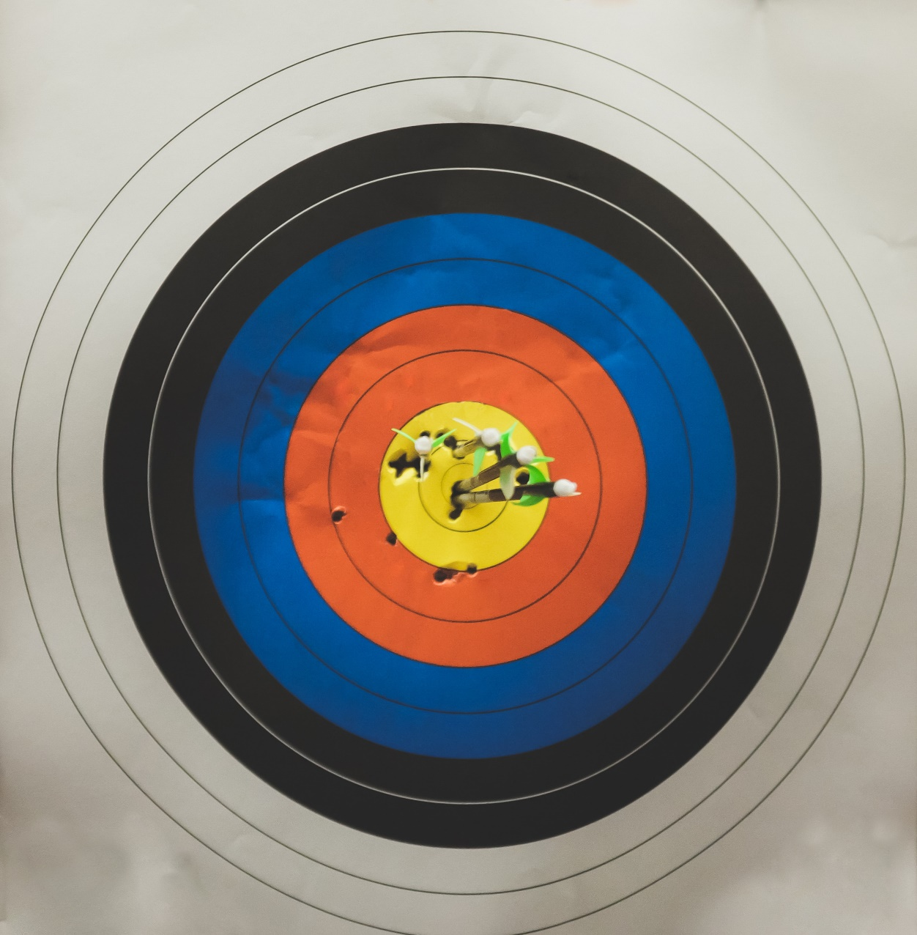
Objectives
Apply the design thinking process to specific challenges
Reflect how the design thinking process and or tools apply to your role
Photo by NeONBRAND on Unsplash
Notes:
Effective design thinking tools on fostering powerful conversations;
Genuine discovery of points-of-view held by different members;
Opportunities for collaborative insights and new ideas for the future;
Energised, positive investment in community development.

Slide 7
Design Thinking
“Design thinking is an approach to designing that supports innovation and intelligent change.”
“Design thinking is a human-centred approach which is driven by creative and analytical thinking, customer empathy, and iterative learning.”
“It involves a toolkit of methods that can be applied to different problems by cross-disciplinary groups or by individuals.”
“Anyone can use design thinking. It can be fun.”
Curedale, R. (2016). Design Thinking Process and Methods. (3rd ed.). Los Angeles, CA: Design Community College. p.62

Slide 8





Approach
Empathise
Develop a deep understanding of your end users using ethnographic research methods. Learn about audience and users.
Define
Make sense from your research. What are the insights? What is connected? What are unmet needs and desires of your audience? Clearly articulate and frame the problem you wish to solve.
Ideate
Brainstorm lots of creative and potential solutions. Select the best solutions from the view of people, technology and business.
Prototype
Build a representation of of your ideas to test all or part of your solution. Create a series of fast prototypes to test your design direction. Showing is better than telling.
Test
Engage in a continuous, short cycle innovation process to improve your design. Get feedback from end users and a variety of stakeholders.

Slide 9
Approach
Empathise
Develop a deep understanding of your end users using ethnographic research methods. Learn about audience and users.
.

Slide 10
Approach
Empathise
Develop a deep understanding of your end users using ethnographic research methods. Learn about audience and users.
Define
Make sense from your research. What are the insights? What is connected? What are unmet needs and desires of your audience? Clearly articulate and frame the problem you wish to solve.

Slide 11
Approach
Empathise
Develop a deep understanding of your end users using ethnographic research methods. Learn about audience and users.
Define
Make sense from your research. What are the insights? What is connected? What are unmet needs and desires of your audience? Clearly articulate and frame the problem you wish to solve.
Ideate
Brainstorm lots of creative and potential solutions. Select the best solutions from the view of people, technology and business.
.

Slide 12
Approach
Empathise
Develop a deep understanding of your end users using ethnographic research methods. Learn about audience and users.
Define
Make sense from your research. What are the insights? What is connected? What are unmet needs and desires of your audience? Clearly articulate and frame the problem you wish to solve.
Ideate
Brainstorm lots of creative and potential solutions. Select the best solutions from the view of people, technology and business.
Prototype
Build a representation of of your ideas to test all or part of your solution. Create a series of fast prototypes to test your design direction. Showing is better than telling.

Slide 13
Approach
Empathise
Develop a deep understanding of your end users using ethnographic research methods. Learn about audience and users.
Define
Make sense from your research. What are the insights? What is connected? What are unmet needs and desires of your audience? Clearly articulate and frame the problem you wish to solve.
Ideate
Brainstorm lots of creative and potential solutions. Select the best solutions from the view of people, technology and business.
Prototype
Build a representation of of your ideas to test all or part of your solution. Create a series of fast prototypes to test your design direction. Showing is better than telling.
Test
Engage in a continuous, short cycle innovation process to improve your design. Get feedback from end users and a variety of stakeholders.

Slide 14
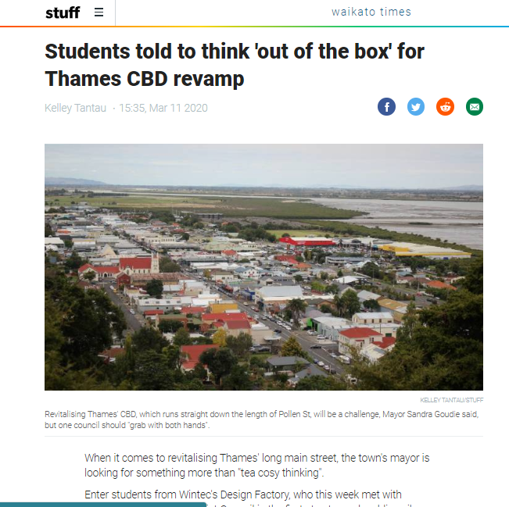
BENEFITS of Design Thinking ?
People centered approach
Reduce risks of a partial approach
Holistic perspective
Reduces duplication
Enhances synergies
Better targeted solutions
Stronger reality checks at earlier stages
Resilient solutions

Slide 15
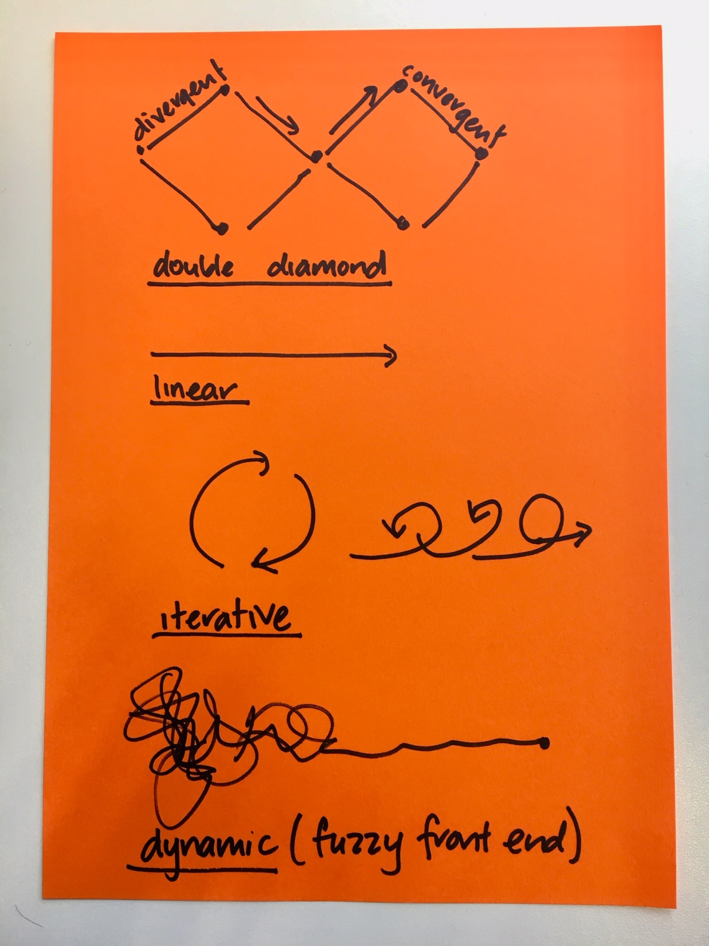

The approach is….
both divergent and convergent (problem space and solution space)
linear
iterative
dynamic
fuzzy front end

Slide 16
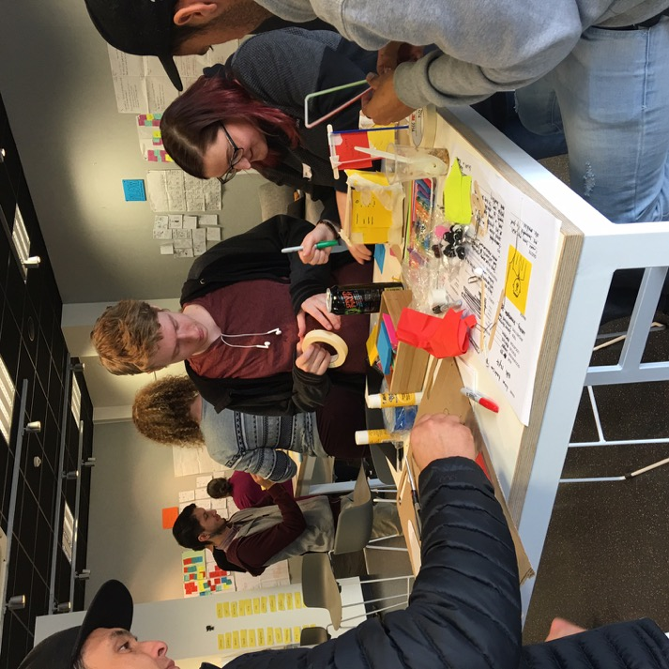
Principles we use when design thinking
Lean into uncertainty
Preference to action
Open minded
Feedback is a gift
Defer judgement
Encourage wild ideas
Build on each others' ideas

Slide 17
Your challenges today are …

Slide 18
Your challenges today are …
How might we collaborate with community and volunteer groups to contribute to social wellbeing in our district?
How might we reduce rubbish to landfill in our district?
How might we reimagine our libraries to meet the needs of our community now and in the future?

Slide 19
Empathy – once we have identified a challenge we set about gathering and documenting as much as we can to understand the challenge.
.

Slide 20

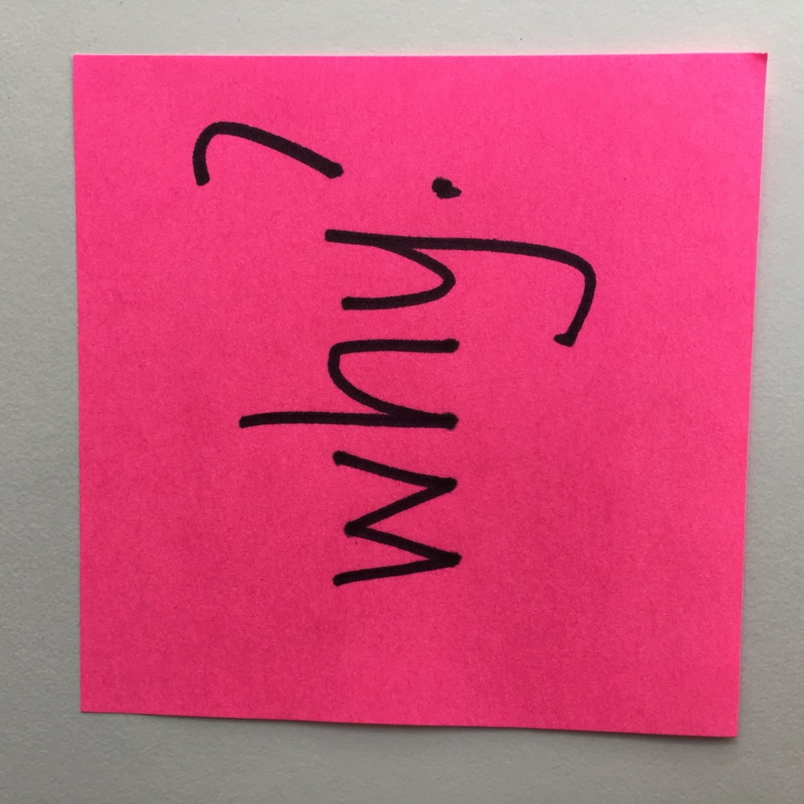
Empathy
Why we value empathy
What we think about
Who is the user?
What are their needs?
What are their expectations?
What are their motivations?
What are their aspirations?
How do we find this out?
What are their stories?
What has been their journey?

Slide 21

Empathy ….
Why we value empathy: It helps us…
Understand others
Stand in someone else’s shoes
Reduce our own bias
Understand the users motivations feelings and view points
It builds trust
Hear viewpoints we wouldn't normally
Gives us valuable information and insights to test future solutions

Slide 22

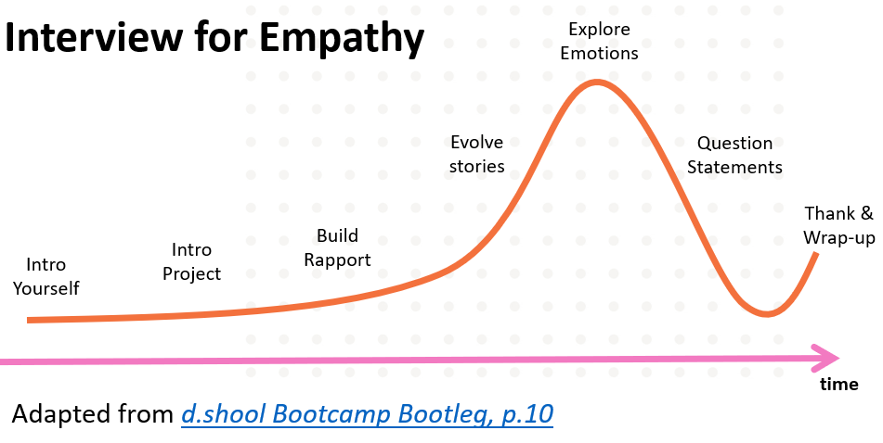

Slide 23
In your groups
We are part of a Design Thinking workshop with Design Factory New Zealand, and we are investigating the question…
Develop questions – some possible ones
Tell me about the experiences you have had volunteering (or attending an event which was run by volunteers)
What does social wellbeing in our district look like to you? Now and in the future?
Tell me about the rubbish you see going to landfill in our district?
What do you send to landfill and why?
Tell me about the last time you used the library? Why did you use the library?
What do you think libraries will look like in 10 years time?
For anyone
Tell me about how you find living in our district?
If you had a magic wand what would you change right now and why?
Practice amongst yourselves and refine your questions

Slide 24
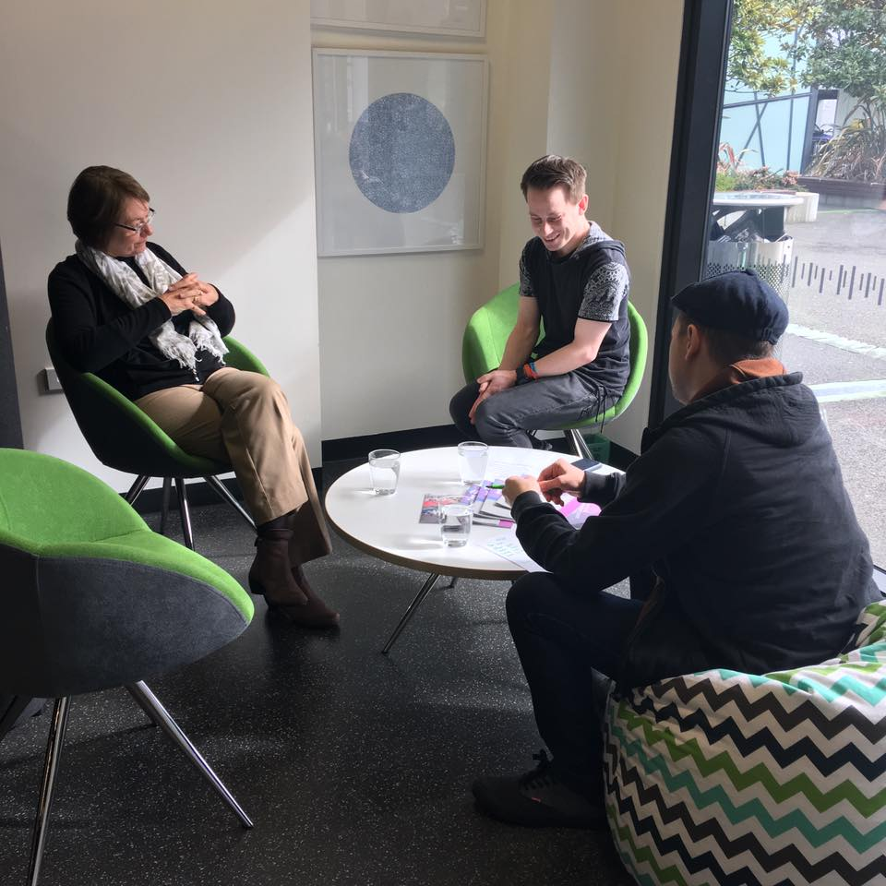
Interviews
In pairs, go and interview 3 different people who can help you to understand your challenge
One person to lead the interview, one to take lots of notes.

Slide 25

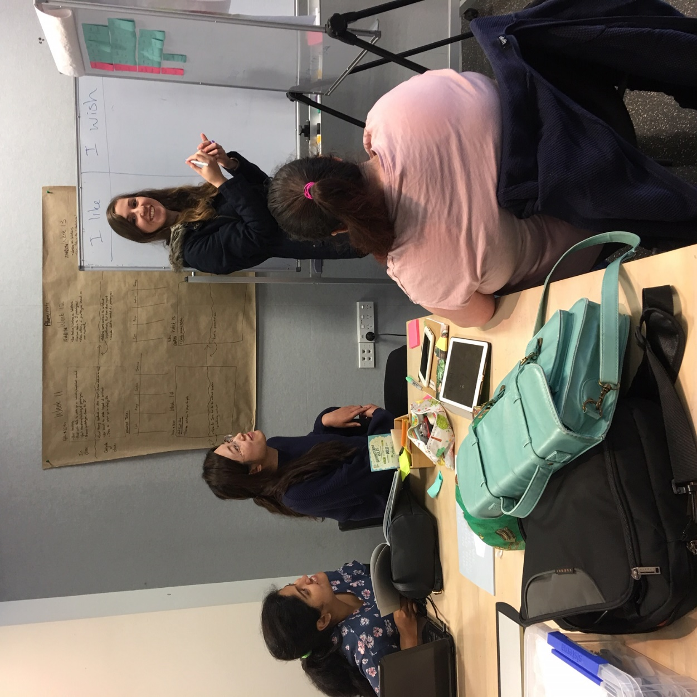
Empathy interviews -
Tips
Ask open ended questions
Encourage stories
Ask why ( and why and why … )
Dig deep
Listen and observe
Take notes – don’t filter

Slide 26

Take a break !
Have a cuppa
Write up your notes if you want to

Slide 27
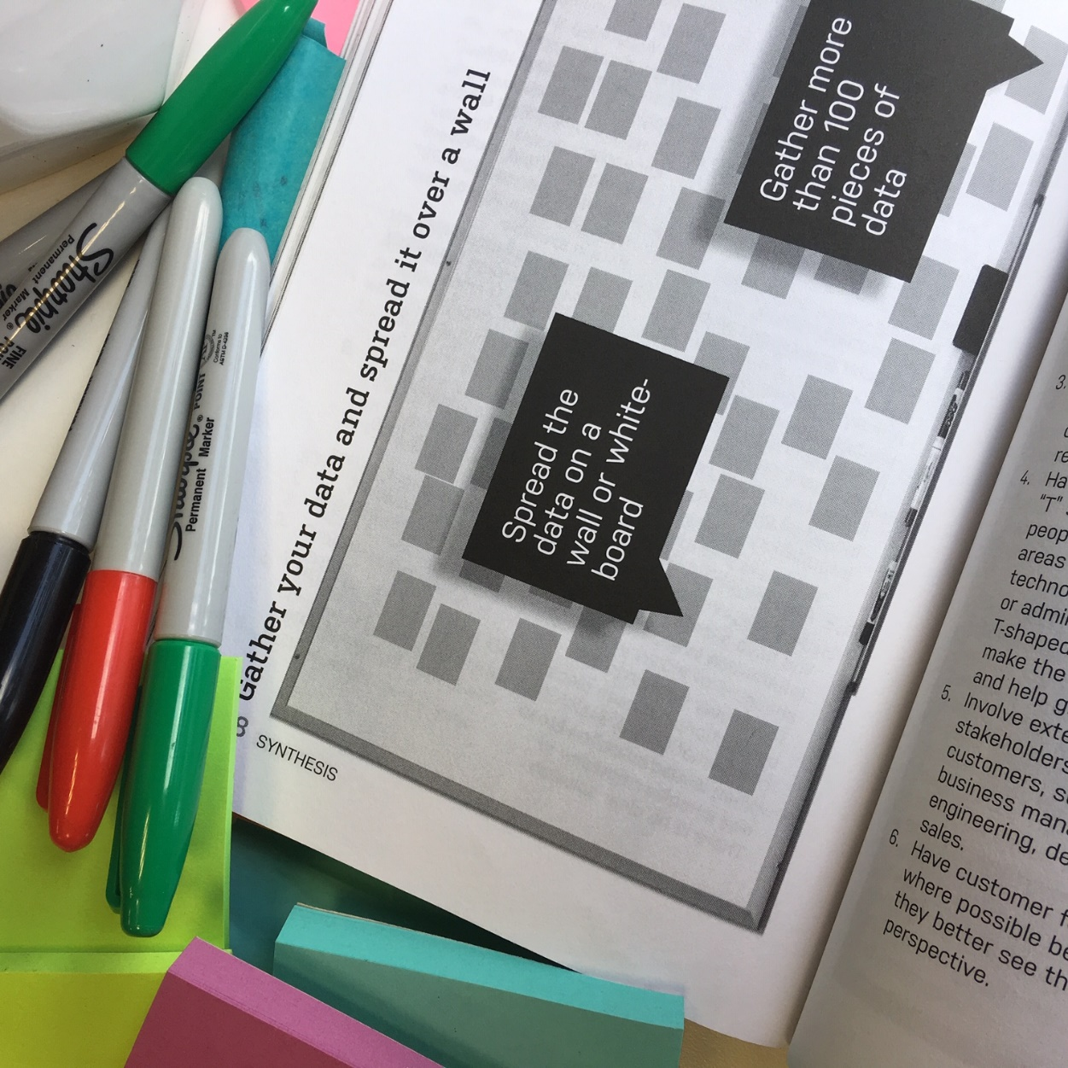
Write up your observations /quotes /what you heard/ what people think/ what you inferred/ what stories they told/ how they acted and place them on the wall chart
Use sharpies
One statement per post-it
Write clearly
.
Image from Curedale, R. (2016). Design thinking: process & methods (4th edition). Los Angeles, CA: Design Community College.

Slide 28
Define – draw upon what you know interpret and weigh up the findings, establish a common knowledge base, identify the real challenge
There are lots of tools - How might we question, affinity map, empathy maps, persona, journey maps, creativity brief – we will use affinity maps and how might we questions
.

Slide 29

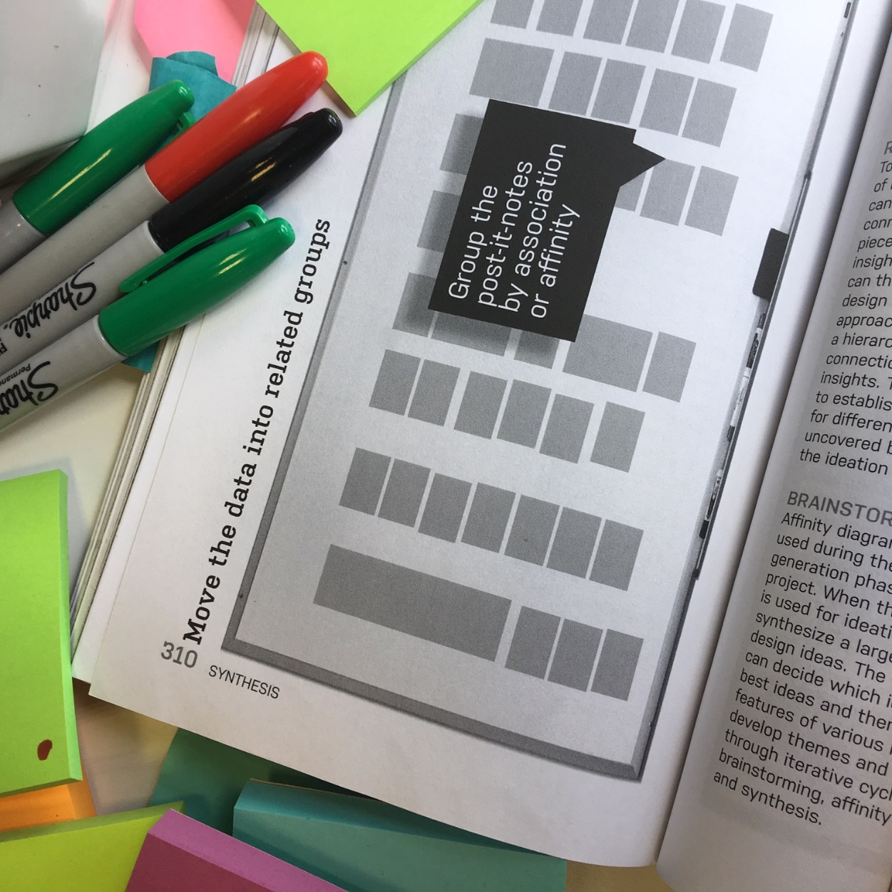
Affinity mapping
Cluster – what things have affinity with each other
Make sense of the cluster by turning it into a sentence (this is called an insight)
E.g. People want to feel welcomed when they attend an event so they are comfortable participating
E.g. When people are welcomed at an event they spend more money.
We look for actionable insights
Image from Curedale, R. (2016). Design thinking: process & methods (4th edition). Los Angeles, CA: Design Community College.

Slide 30
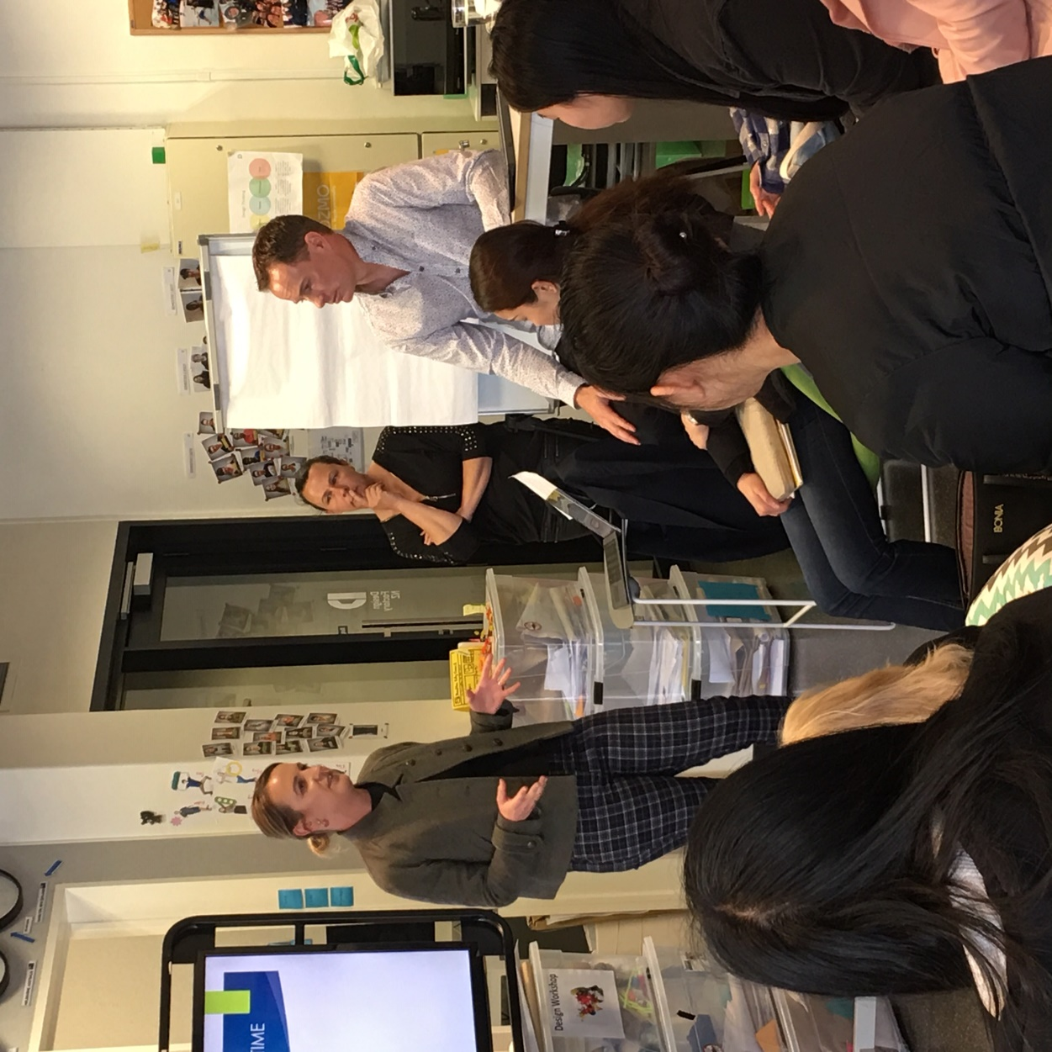
Share back 2-3 insights

Slide 31
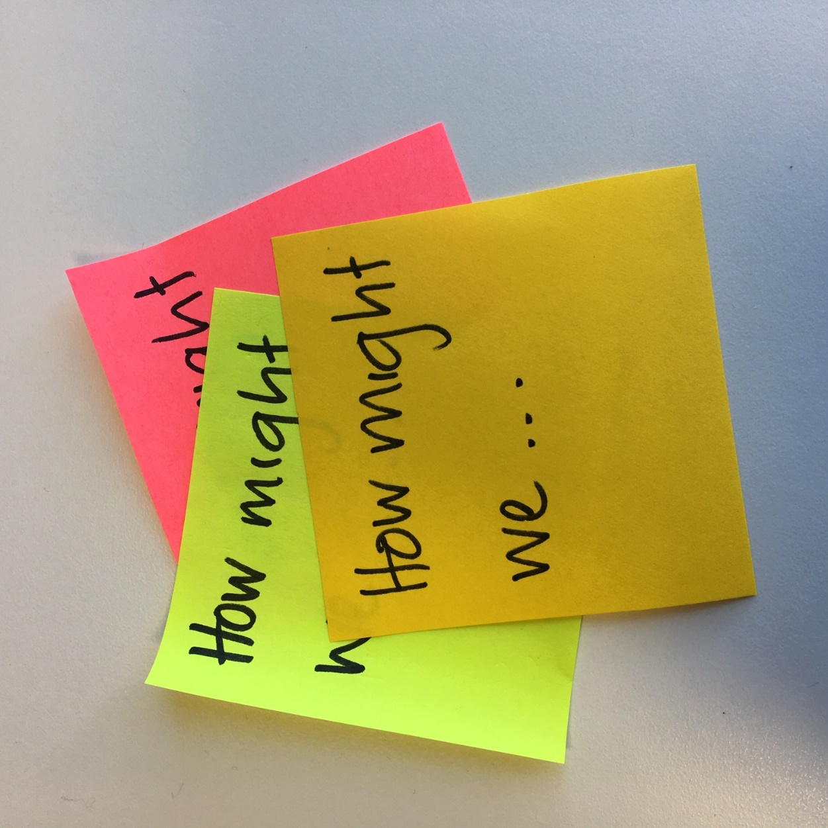
Create a ‘How Might We’ question for 2 or 3 of your insights

Slide 32
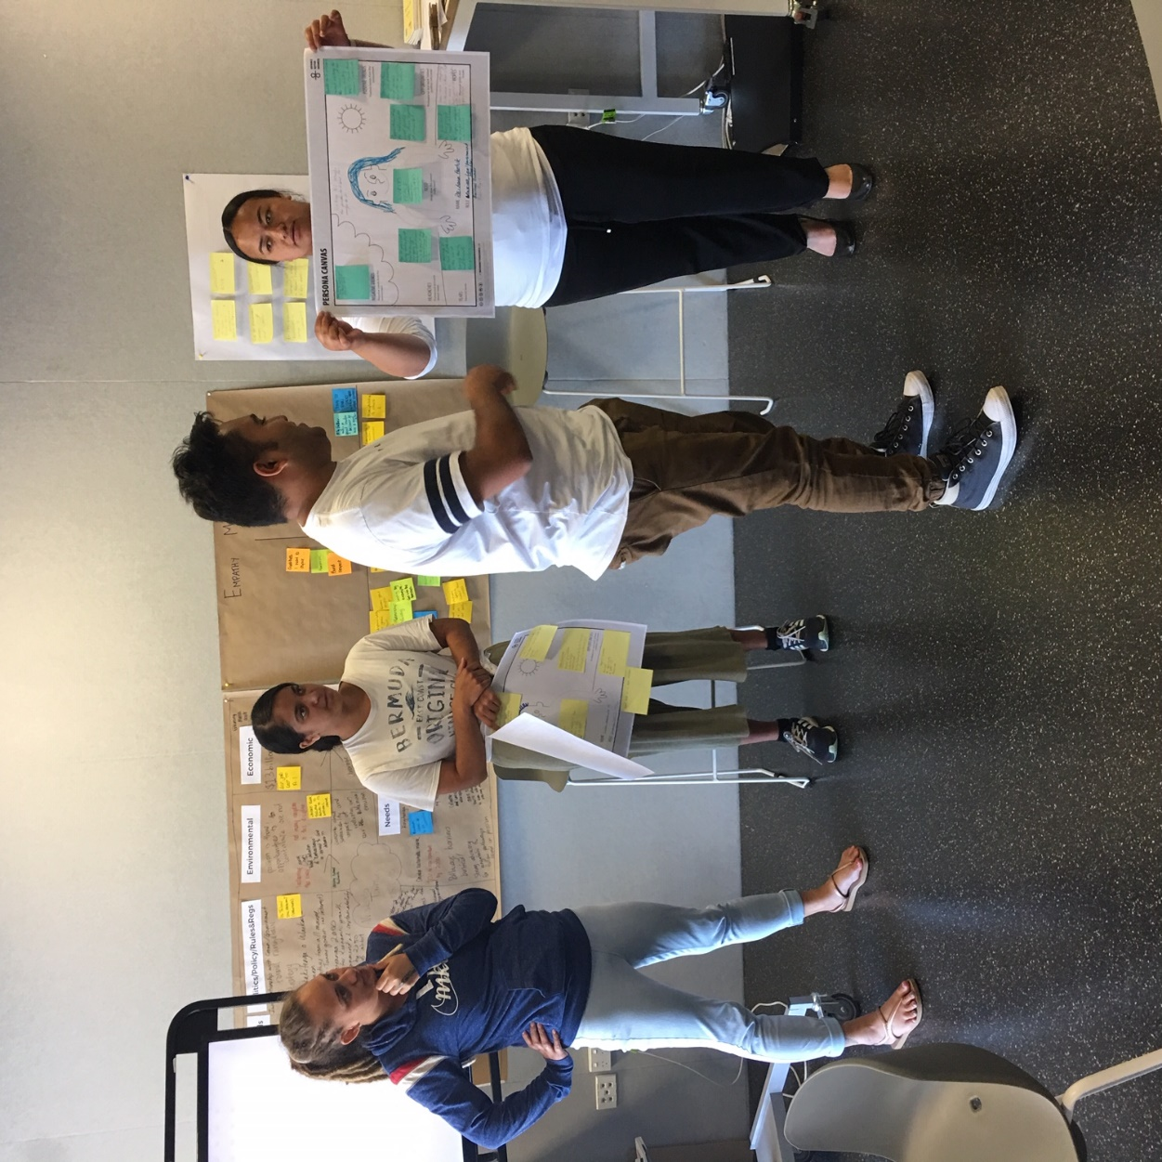
Shareback
Choose one HMW question to focus on as a group
Share it with us

Slide 33
Ideate – at this stage we use various methods and approaches to heighten creativity. It’s a very visual stage and the goal is to develop as many different concepts as possible. It may include or exclude limiting factors
We use various brainstorms, include/exclude limiting factors, lotus, SCAMPER
.

Slide 34
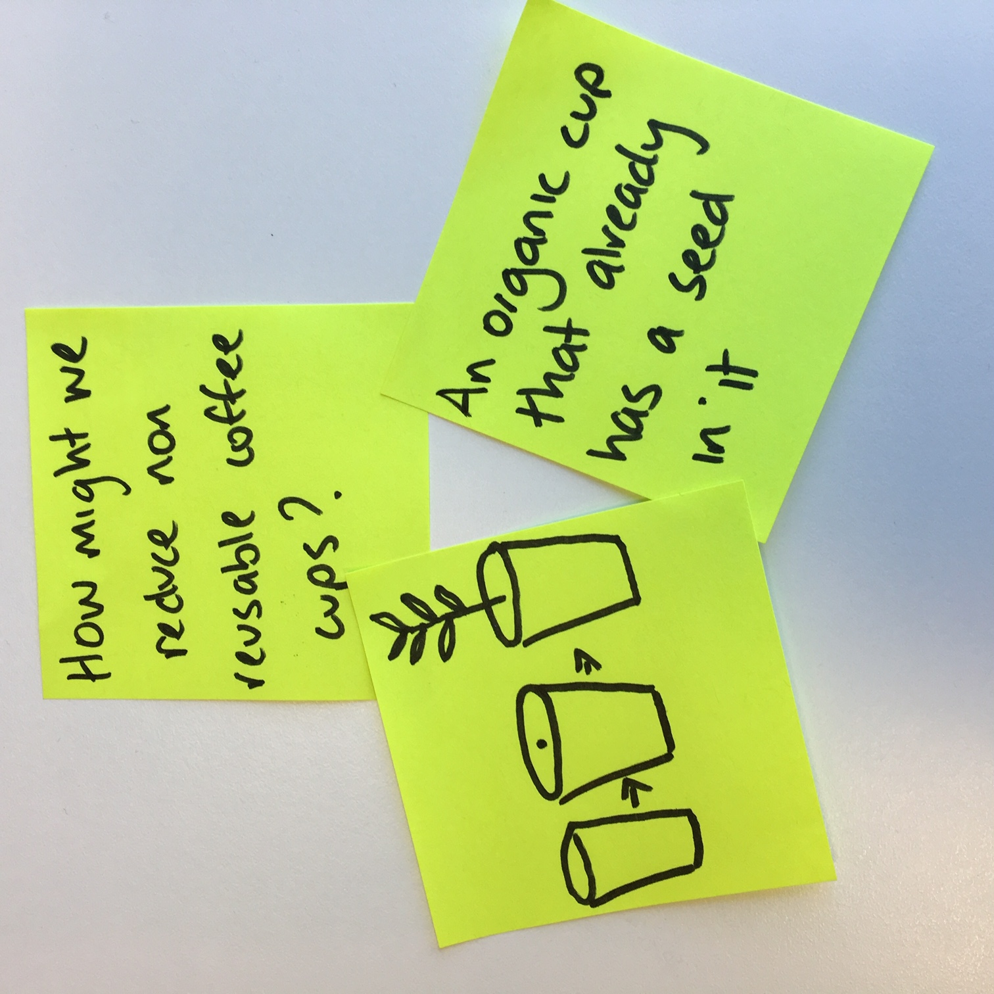
Ideas ….
Clear short sentences.
Diagrams with a bit of detail.
Ideas (not ideals or outcomes)

Slide 35
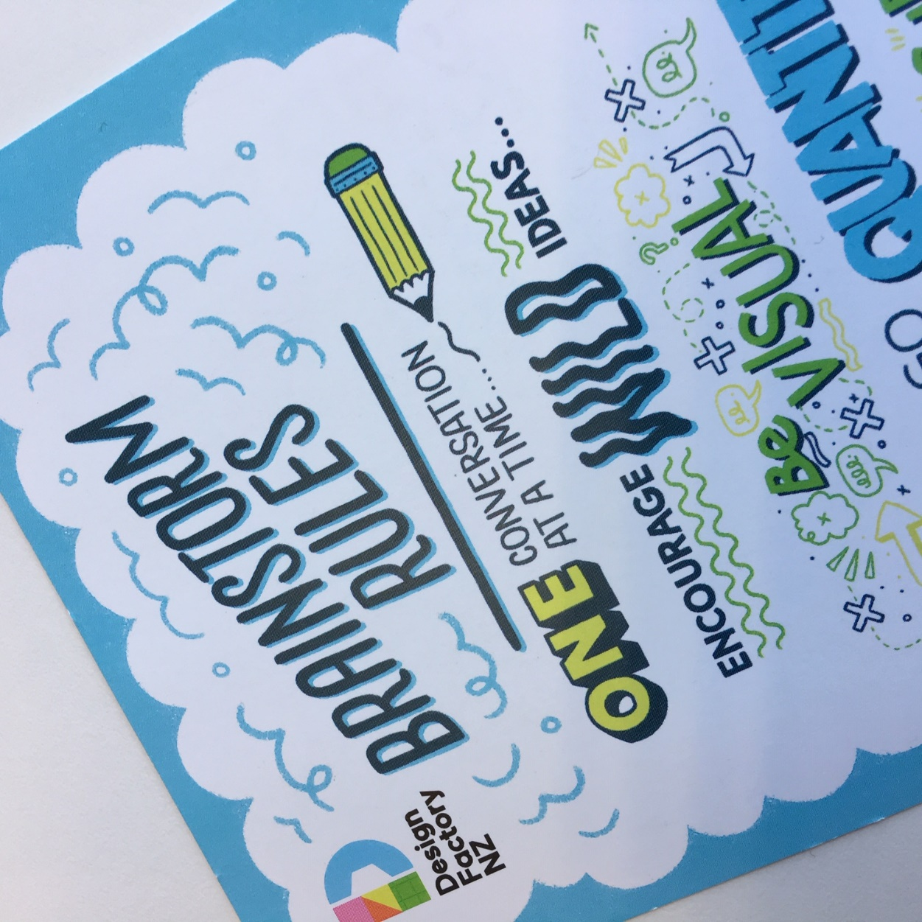
individual brainstorming…on your own
Brainstorming rules
one idea per post-it
be visual
defer judgement
build on each others ideas

Slide 36
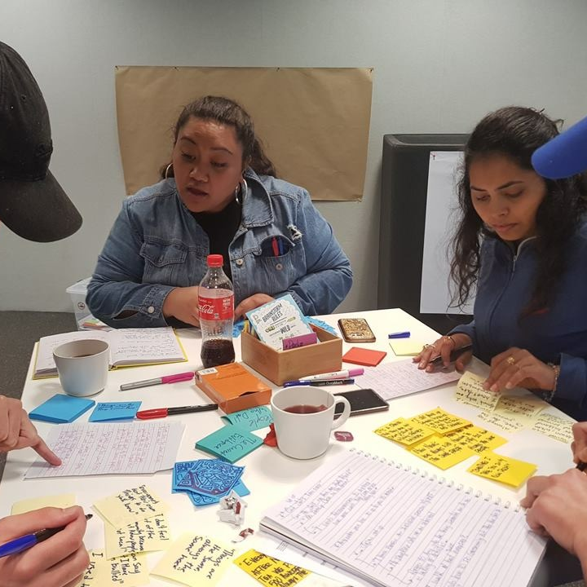
Share and cluster
Make sure everyone speaks and listens – one at a time
Build on ideas
Cluster common ideas

Slide 37
“What if…”
Or come up with your own questions related to your insights.
What If you reverted to old technology?
What if we had a different climate?
What if we were in a different country?
What if we had no land?
What if money was no object?
What if there was no physical presence?
What if we were 30 years / 100 years in the future?
Quick brainstorm - 1 minute individually, 2 minutes as team
Put best ideas on the wall, share, and gather feedback.
Notes:
T1) What if ......
What if you reverted to old technology ? - 2mins -Quick shared feedback
What if we had a different climate ? 2mins -Quick shared feedback
What if we were in a different country ?2mins -Quick shared feedback
What if the problem was the opposite ? 2mins -Quick shared feedback
What if money was no object ? 2mins -Quick shared feedback
What if there was no physical presence ?2mins -Quick shared feedback
What if we were 30 years / 100 hundred years in the future ?2mins -Quick shared feedback
Students record the ideas they want to pursue ...

Slide 38

Heuristic Ideation
Purpose: Create new connections and insights
for the solution.
Instructions:
Use/create two lists of words
Select three words from each list
Develop ideas using these words
Record ideas – quick illustrations/ descriptions on A5
Feedback and record any new ideas.
Notes:
3) Heuristic ideation ( 20 mins and feedback time )– page 494 of the Design Thinking processes and methods. The purpose is to create new connections and insights for the solution, whether it be products , service or experiences. The group will first make two lists of words, each member selects three words from the first list and three from the second , they then use these to develop ideas and record these on cards as illustrations or descriptions. Each idea is shared and pinned up ( in our case withe other concepts they have developed )
We provide each group with cards to create their two lists– technology / human behaviour e.g.
Apps/ online / robot/tool shed tools/ vehicle/ power supply/sensor/ gogo gadgets/ transport/ etc
Seeing- sight / listening- hearing / smell/ movement /reluctance /enthusiasm

Slide 39
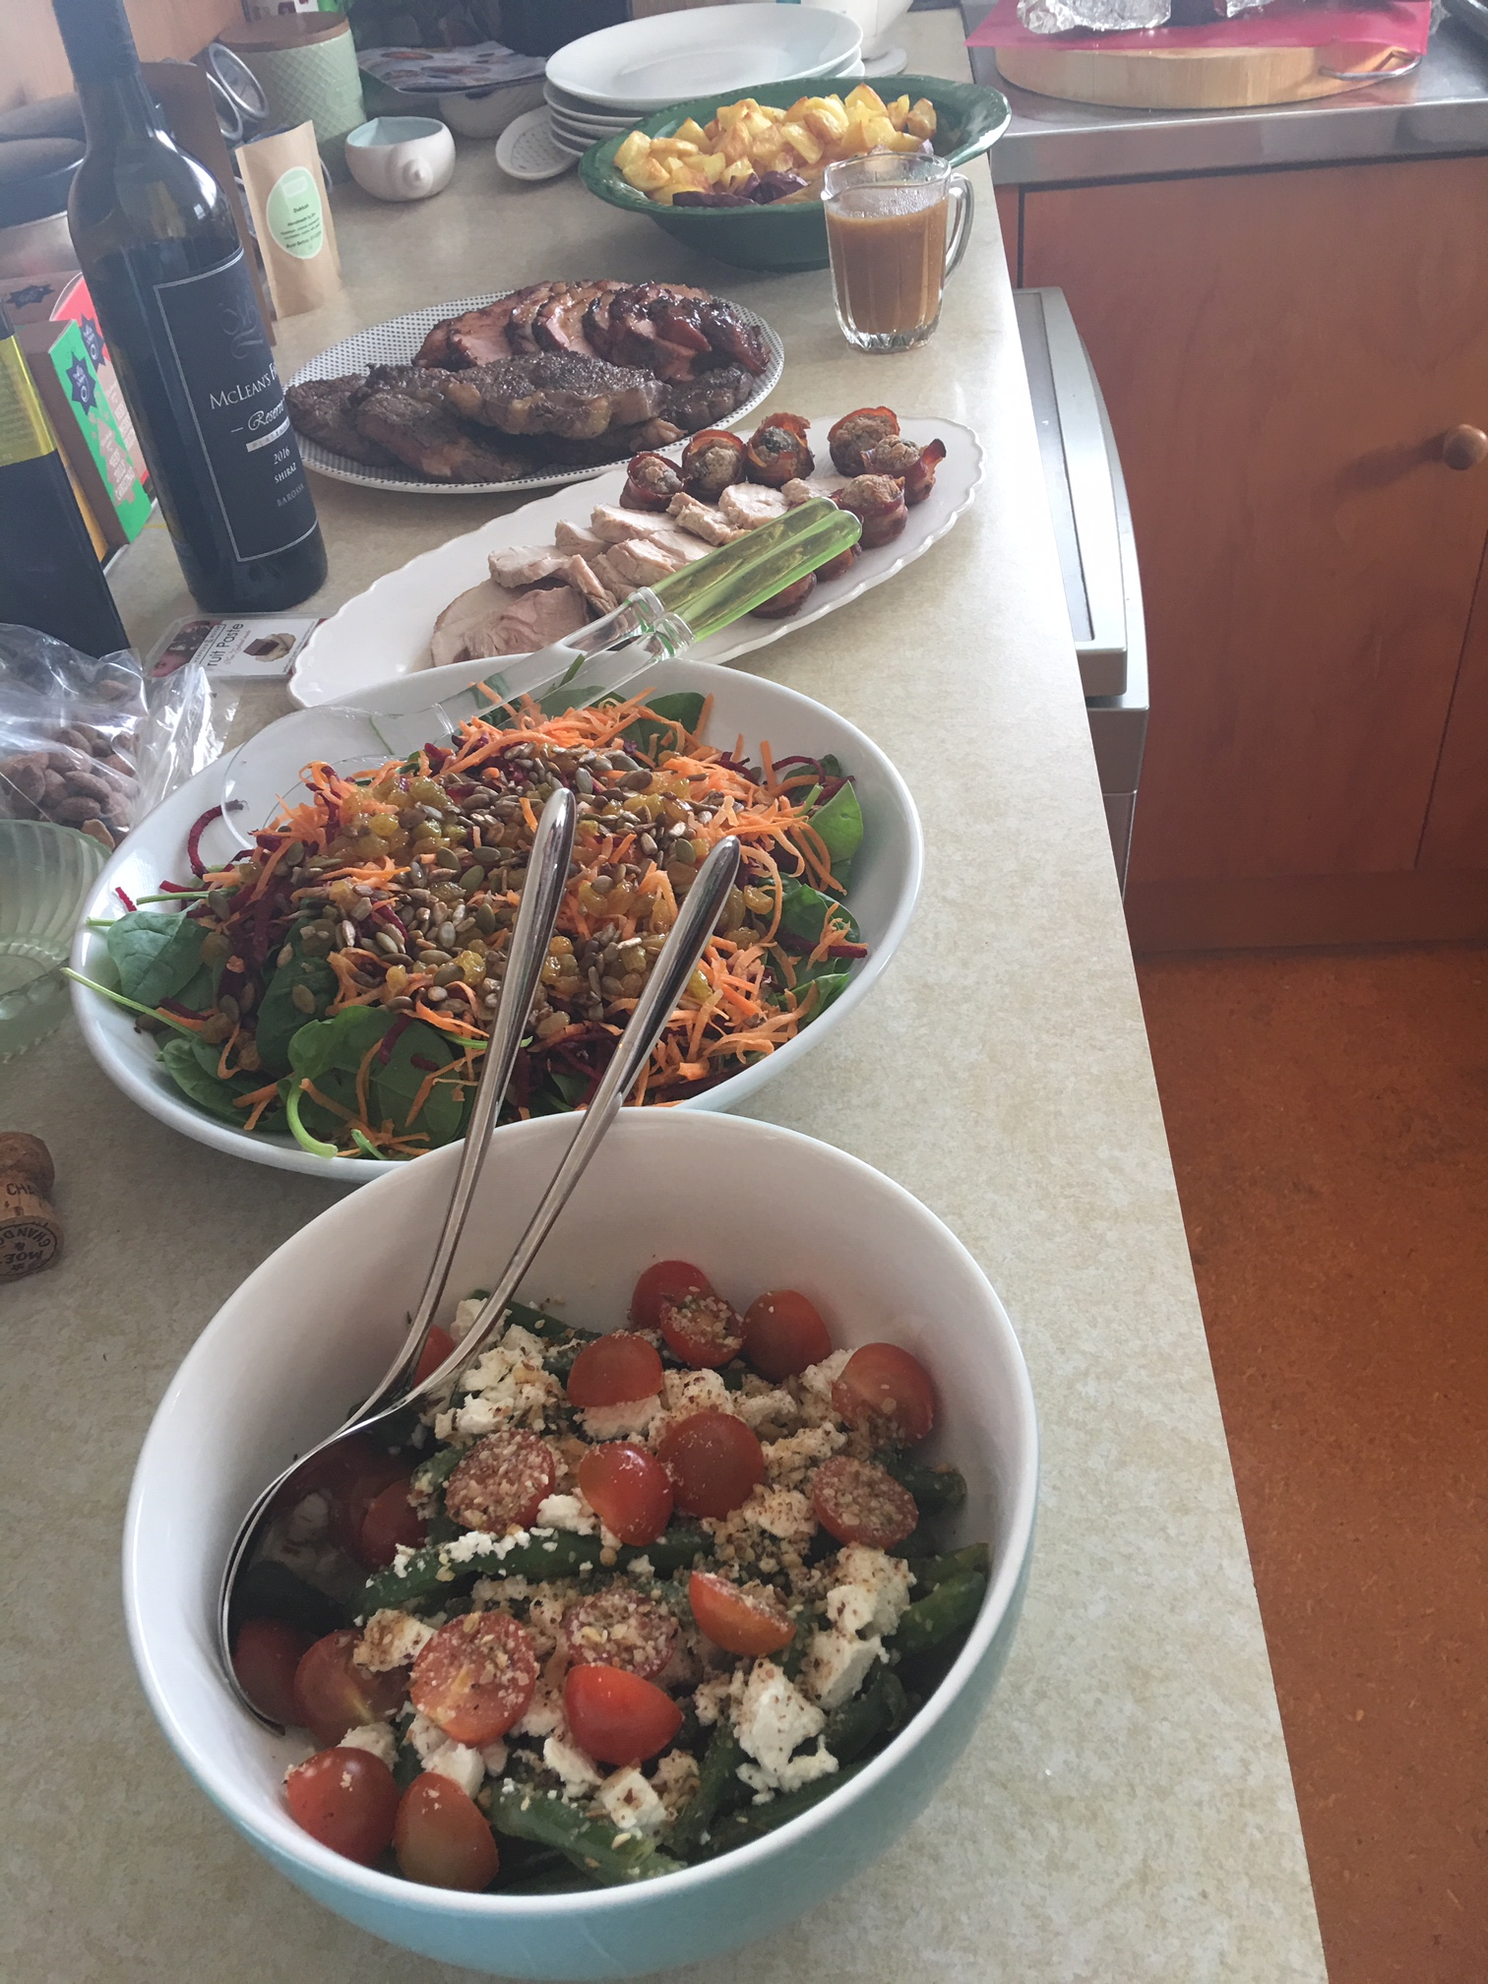

Kai time!

Slide 40
Lets re-energise….
Notes:
Portraits or ?

Slide 41

How would each of these people solve the problem?
Peter Burling
NASA
Michelle Obama
Dame Whena Cooper
Dave Dobbyn
David Attenborough
Mother Theresa
Google

Slide 42
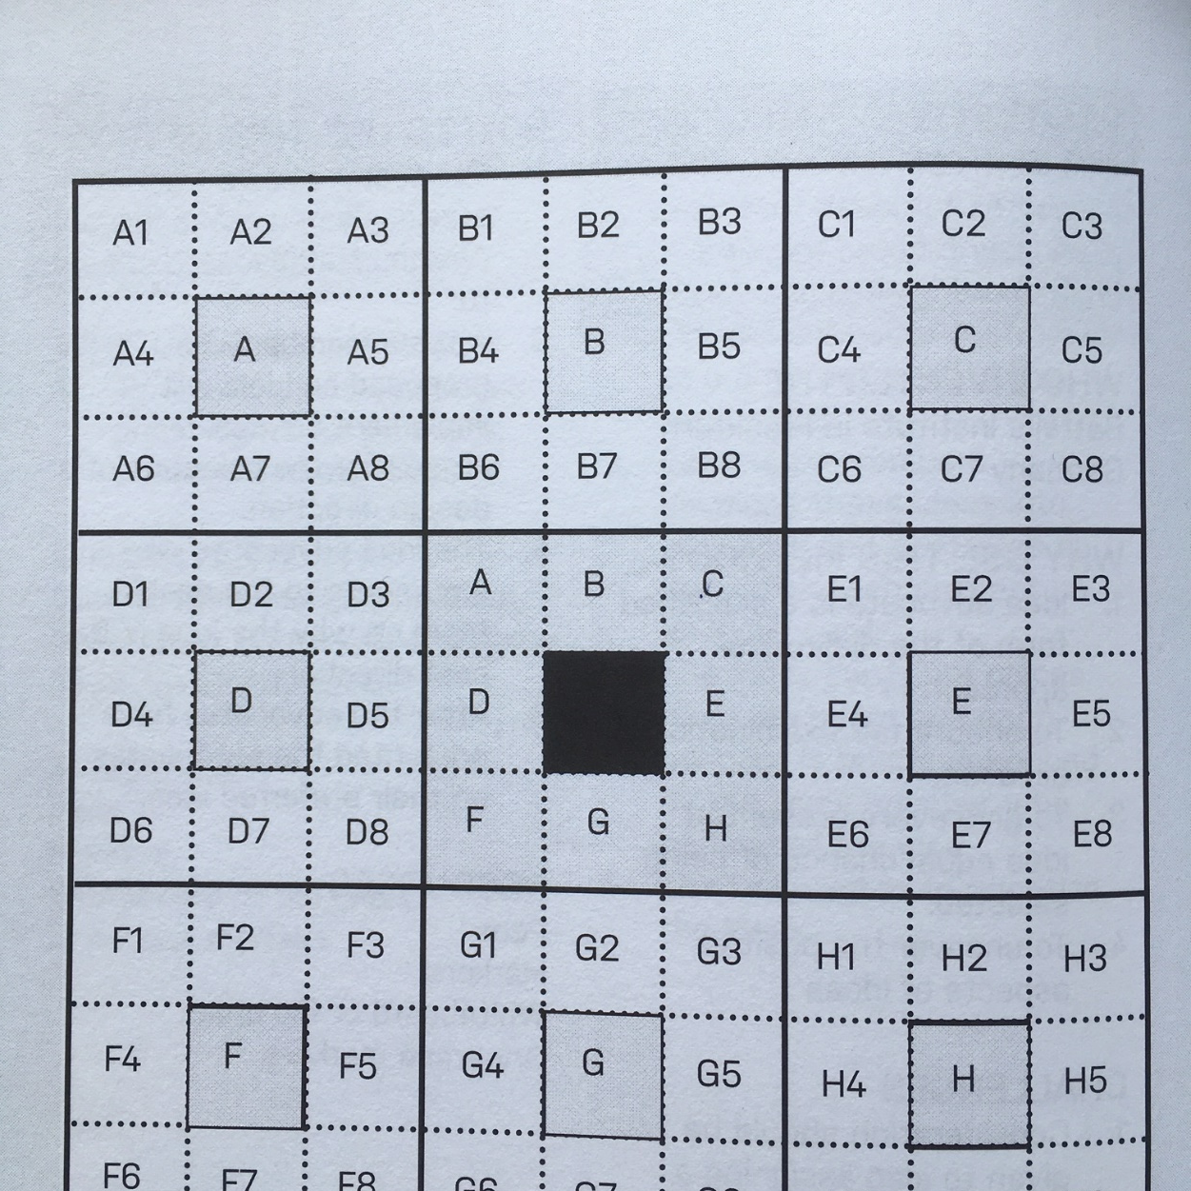
Lotus Blossom
Expand your top idea using the Lotus template.
Write your idea in the centre and as a group come up with 8 different ways of expanding that idea.
Write each expanded idea around the centre.

Slide 43
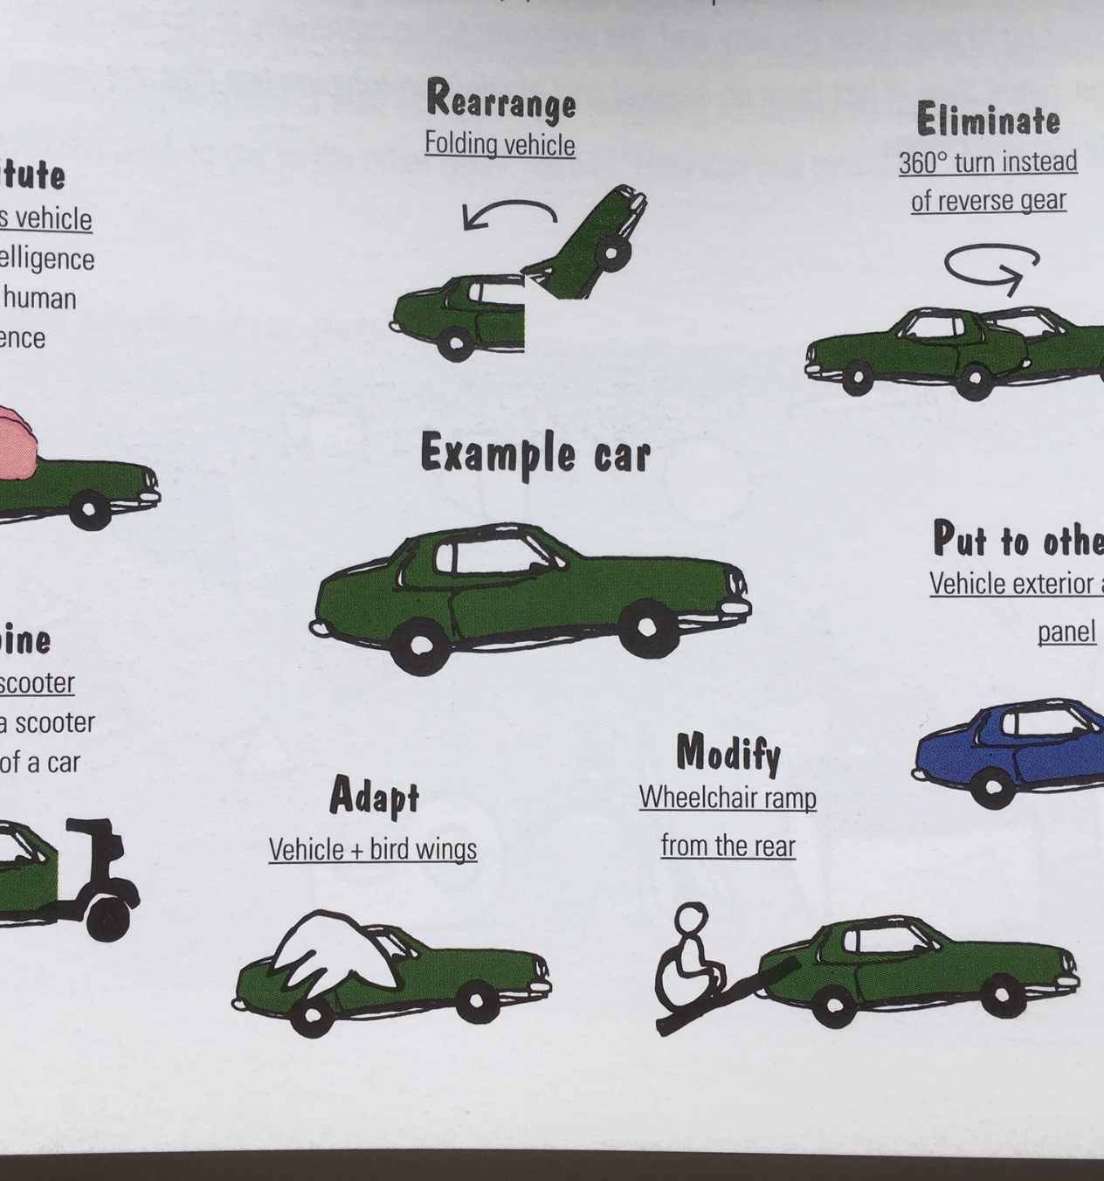
Scamper
Substitute
Combine
Adapt
Modify
Put to other uses
Eliminate
Re-arrange

Slide 44
Top of the Dots
If you had to pick your ‘top 2’ ideas, what might they be?
Let’s use ‘Dot-mocracy’ to help us decide…
Each individual has Two dots to vote for their favourites (from any idea that has been generated)
Top 2 can be chosen from this
If I have a thousand ideas and only one turns out to be good, I am satisfied.
Alfred Nobel

Slide 45
Prototype – a way of showing our ideas in a tangible way very early on
.

Slide 46
Prototype – why?
It can help explain / communicate an idea
Thinking meets doing
Ask questions and develops solutions simultaneously
Promote storytelling
Test your idea –it’s a prop for dialogue and discussion
Feedback is usually honest
Notes:
Bias to action, build to learn and test

Slide 47
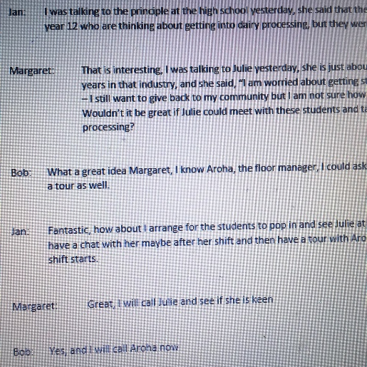
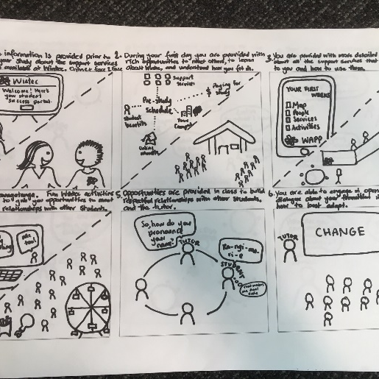
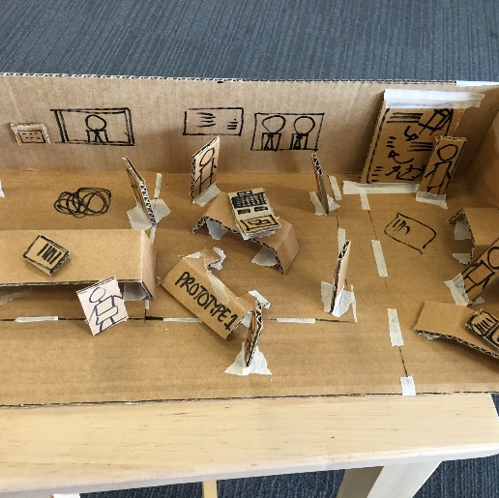
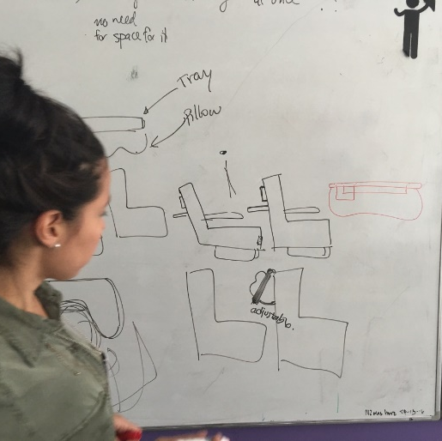
Ways of prototyping
script
storyboard
3_D model
sketch

Slide 48
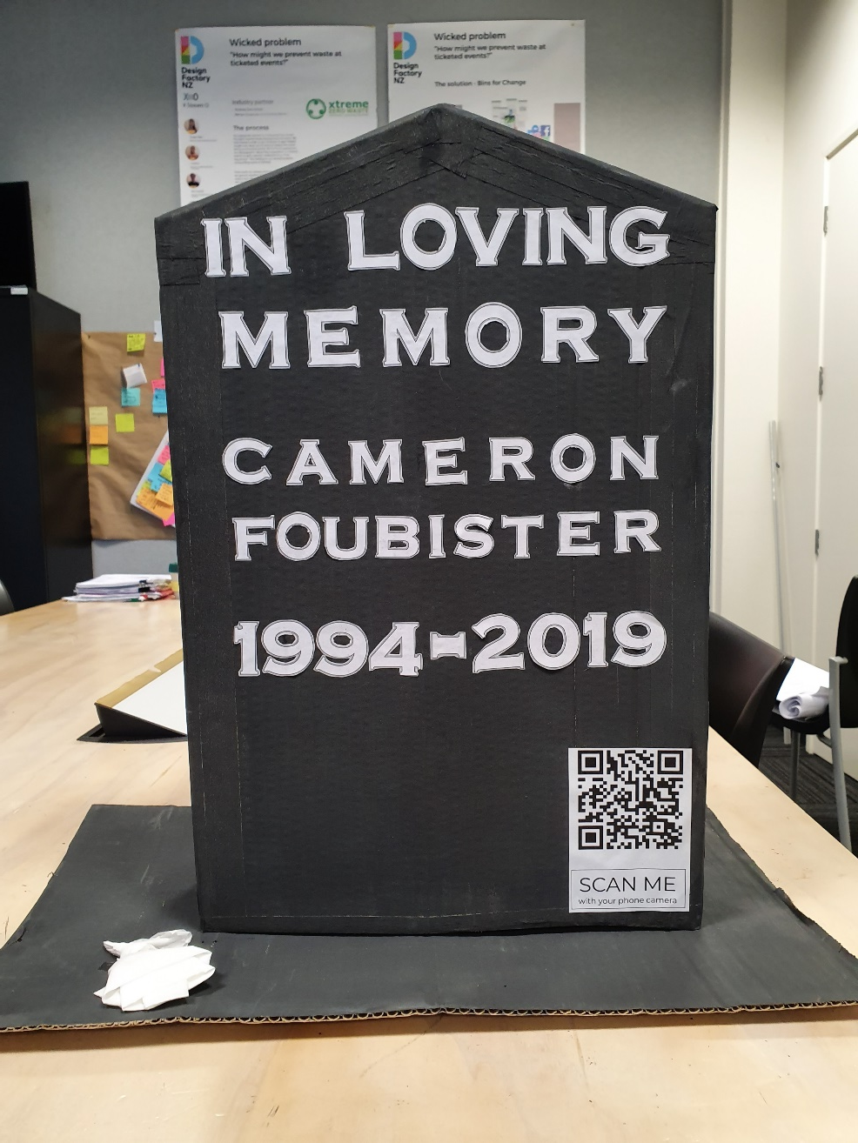
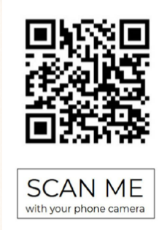
In groups of 2 or 3 choose an idea to prototype
(two prototypes per group)

Slide 49
As a team select one prototype to test and get feedback
Share within your team
As a team, decide which prototype to take out and get feedback on
Prepare questions that will help you test your prototype
Consider roles ( notetaker, observer, interviewer etc )

Slide 50
Test - testing with the users or potential users help us to learn from the feedback, further develop ideas and discard or change until we are happy with our solution
.

Slide 51
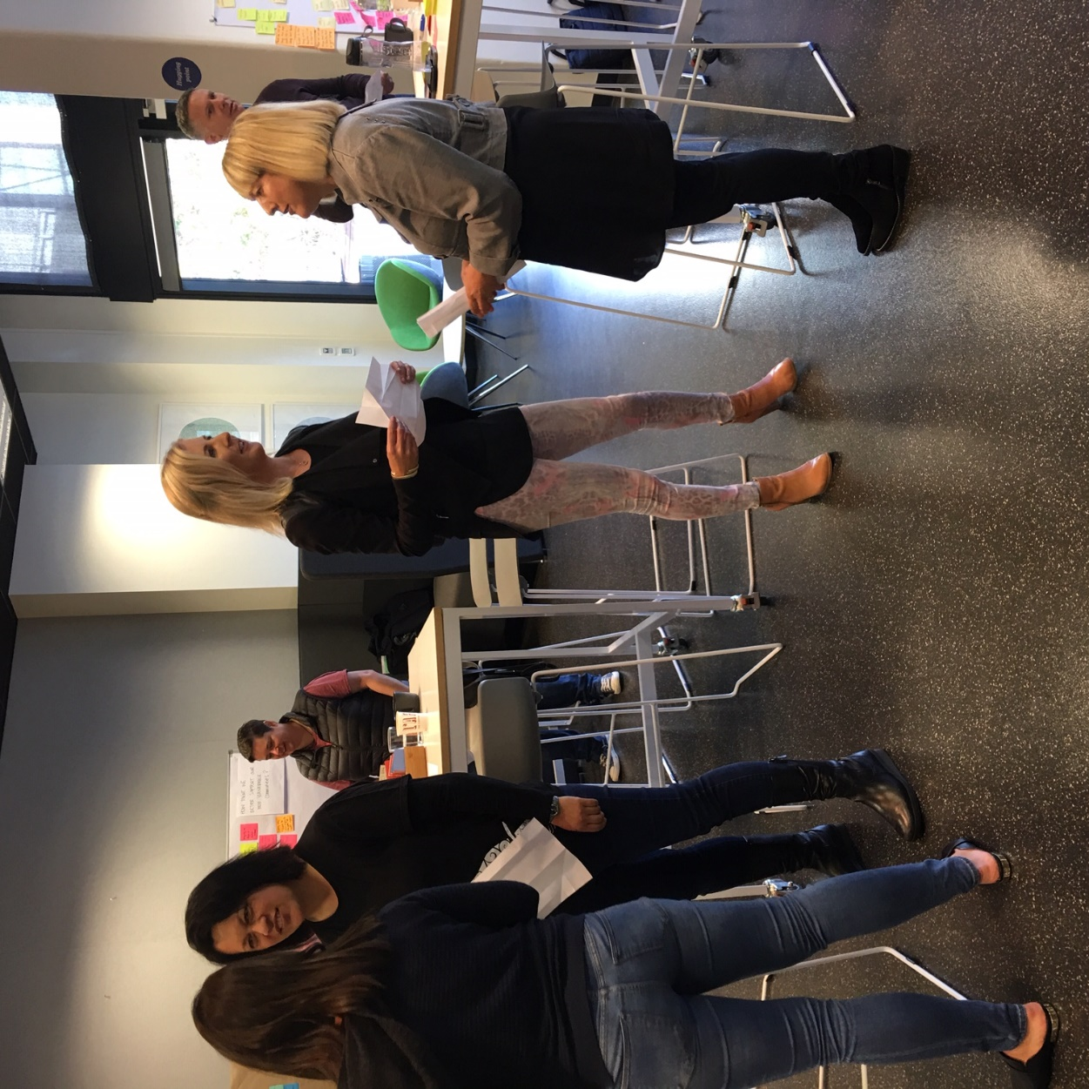
Feedback interviews -
Tips
Seek honest feedback
Don’t be tempted to defend your idea- listen only
Try it on a wide range of people
Don’t filter/ plenty of notes
Hand it to them to and observe

Slide 52
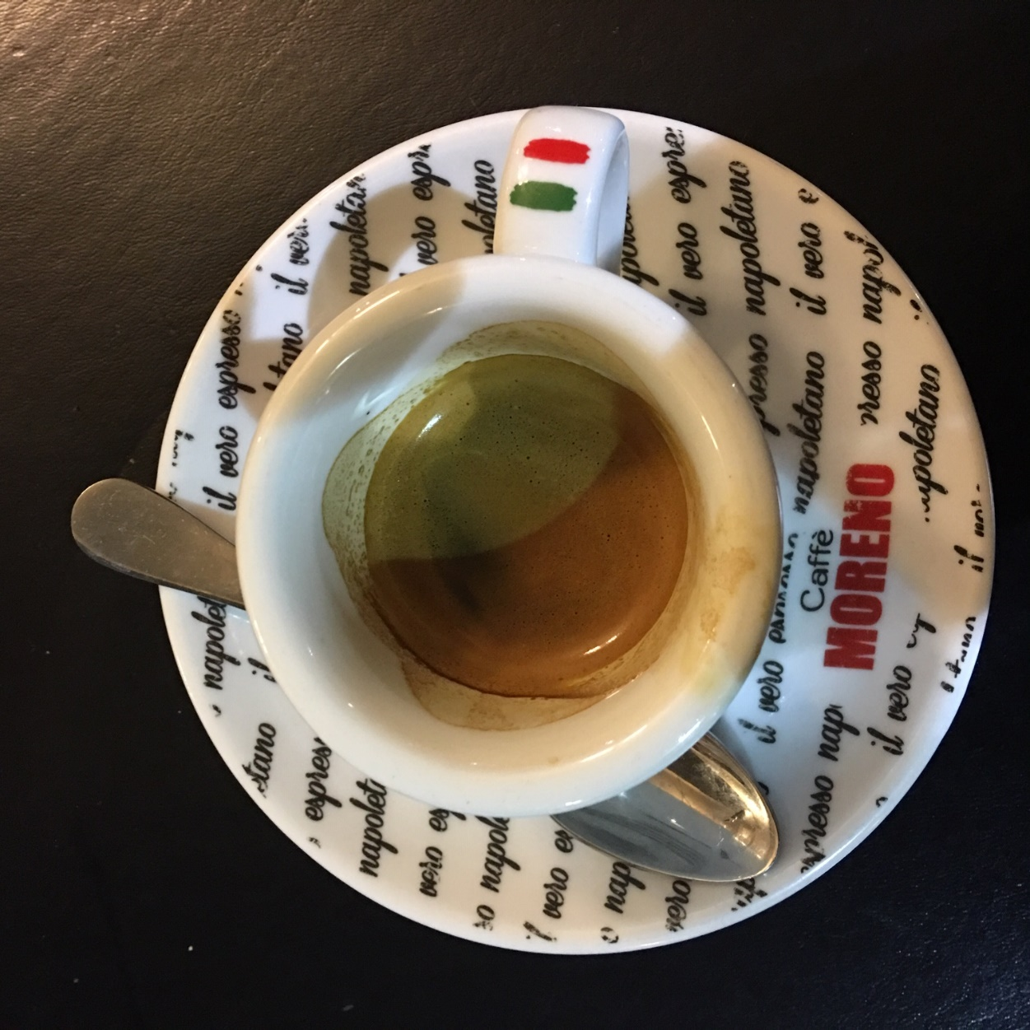
Working while we snack and drink

Slide 53
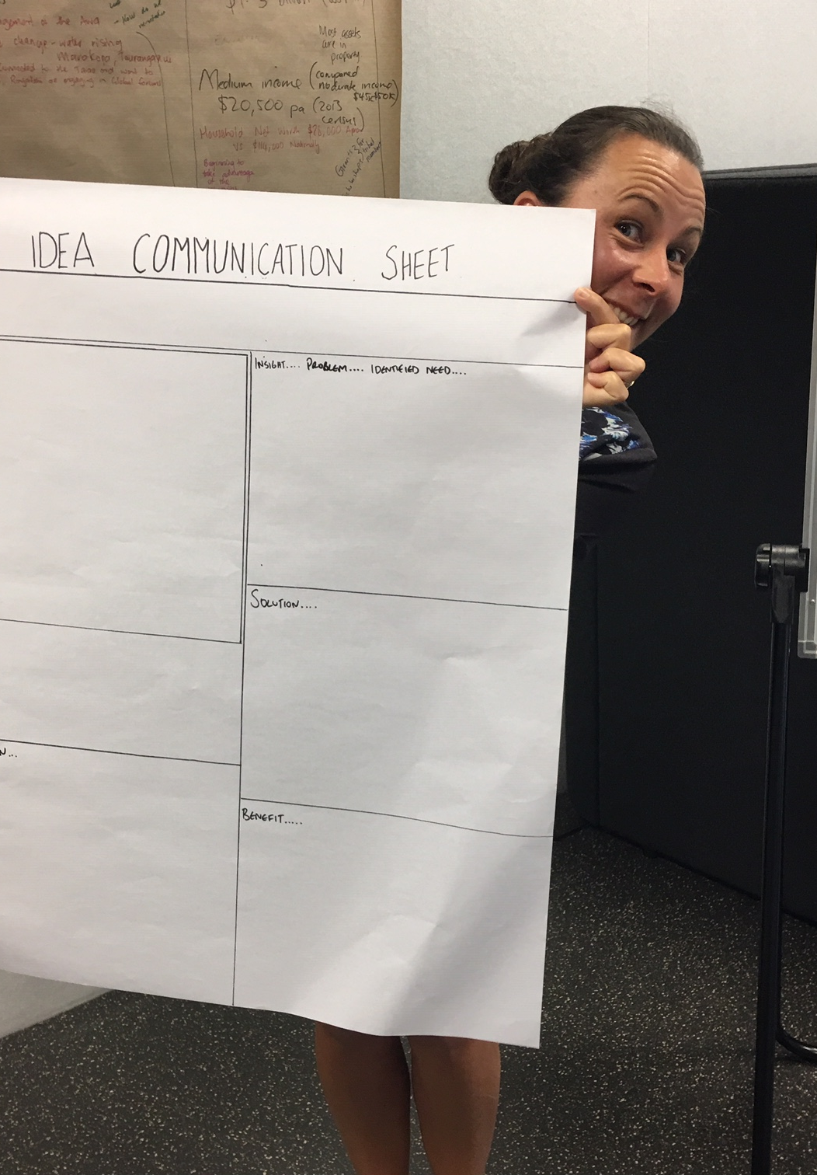
Iterate and present your ideas
Incorporate the feedback and make changes to your prototype.
Prepare your story
Our challenge is ….
We found out that ….
So we designed ….
It will solve the challenge by…..
After testing we found out that………

Slide 54
Approach
Empathise
Develop a deep understanding of your end users using ethnographic research methods. Learn about audience and users.
Define
Make sense from your research. What are the insights? What is connected? What are unmet needs and desires of your audience? Clearly articulate and frame the problem you wish to solve.
Ideate
Brainstorm lots of creative and potential solutions. Select the best solutions from the view of people, technology and business.
Prototype
Build a representation of of your ideas to test all or part of your solution. Create a series of fast prototypes to test your design direction. Showing is better than telling.
Test
Engage in a continuous, short cycle innovation process to improve your design. Get feedback from end users and a variety of stakeholders.

Slide 55
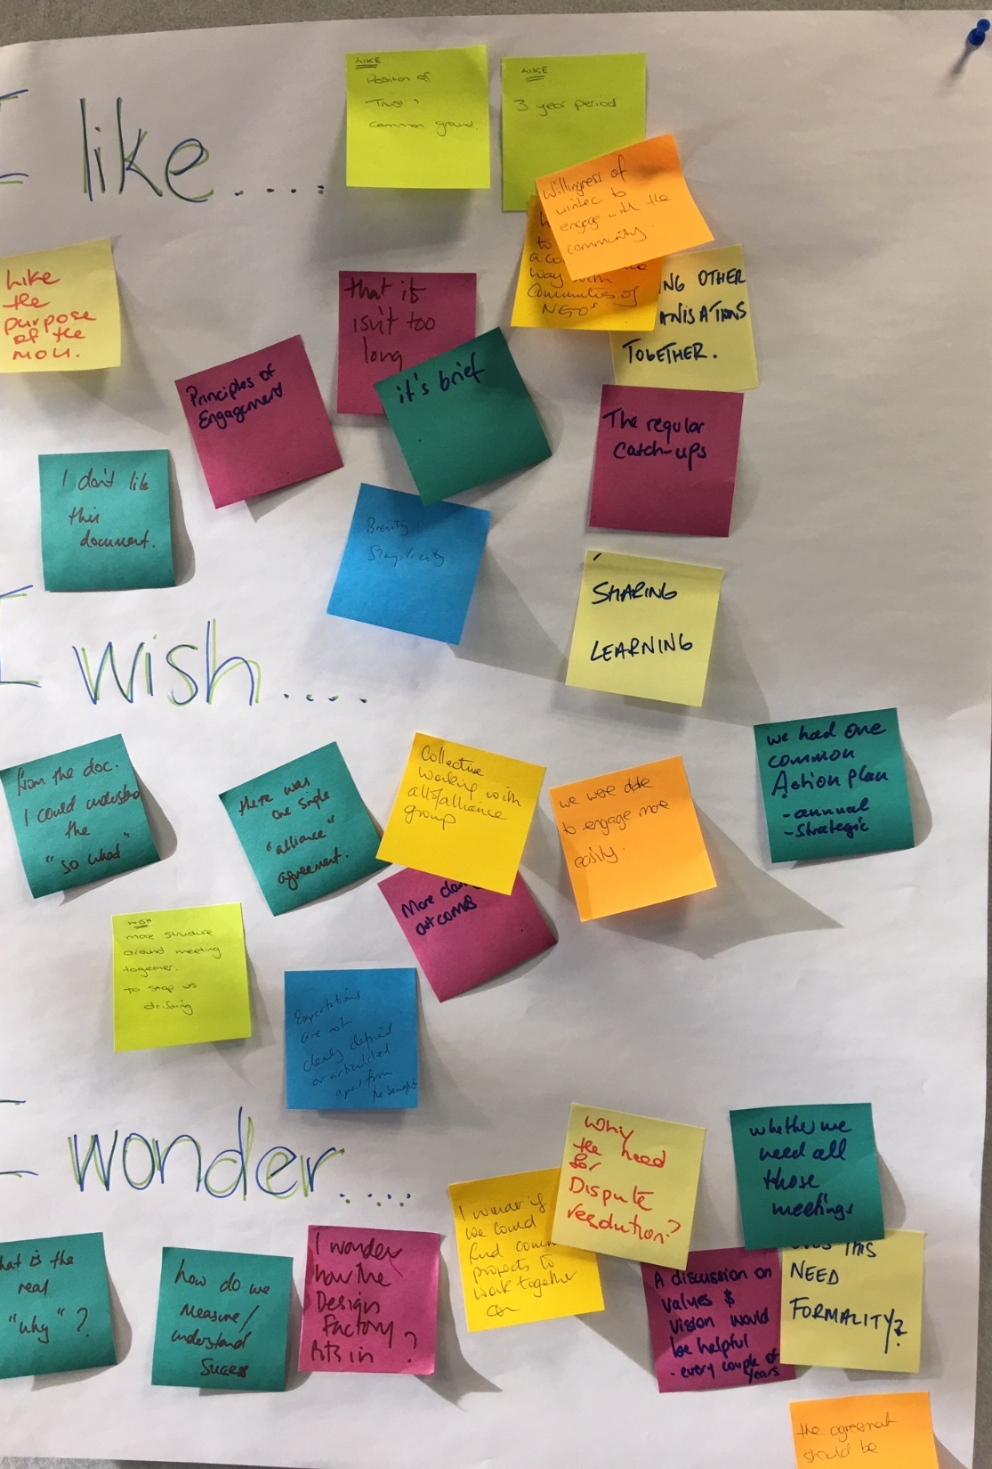
I like , I wish , I wonder

Slide 56
In your work teams….
Brainstorm two to three things you could do utilise or do differently based on your experience from today
Shareback

Slide 57
Whakatauki
Mahia Te mahi hei painga mo Te iwi
We do this for the betterment of the people

Slide 58

Reflection and feedback for us
I like ….
I wish ….
I wonder …..

Slide 59
References
Curedale, R. (2016). Design thinking: process & methods (4th edition). Los Angeles, CA: Design Community College.
Kelley, T., & Kelley, D. (2013). Creative confidence. Unleashing the creative potential within us all. New York, NY: Crown Business.
Lewrick, M., Link, P., & Leifer, L. (2018). The design thinking playbook. Hoboken, NJ: John Wiley & Sons Inc

